Slide 1
Simulating magnetic interactions of microgrippers designed for pollutant removal in wastewater
Diego Martinez Valencia
Electronics Engineer
M.Sc student | Electronics Eng. And Computer science

Slide 2
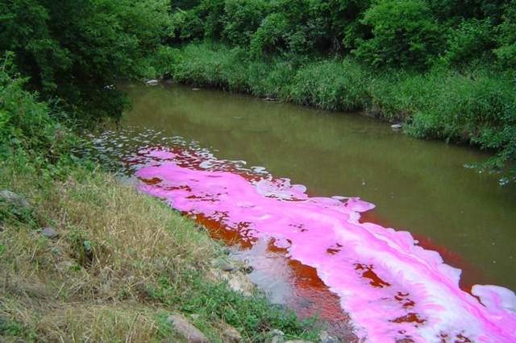
Introduction
Most of the wastewaters are discharged directly into bodies of water such as rivers without any type of pretreatment, this causes a huge impact on the hole ecosystem.
https://www.sixdegreesnews.org/archives/25949/textile-industry-under-pressure-to-detox-fashion

Slide 3
Contamination by industries
Amount of water produced (M^3/Ton)
Color concentration [Hazen units]
Sugar
Beer
Tanning
Paper
Textile
The usage of synthetic dyes or azo-type dyes can reach up to 75 tons per year. These type of dyes generate depletion of dissolved oxygen and interfere with photosynthetic processes.
Martínez, A. C., Olivares, C. C., Lozada, A. E., & Ramírez, C. G. (2014). Contaminación generada por colorantes de la industria textil. Vida Científica Boletín de la Escuela Preparatoria No. 4, 2(3).

Slide 4
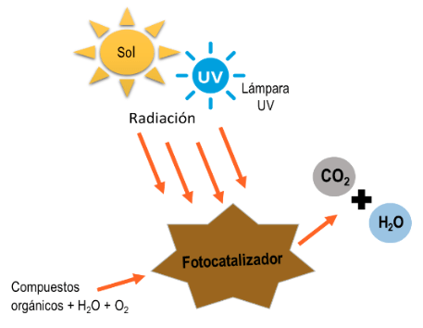
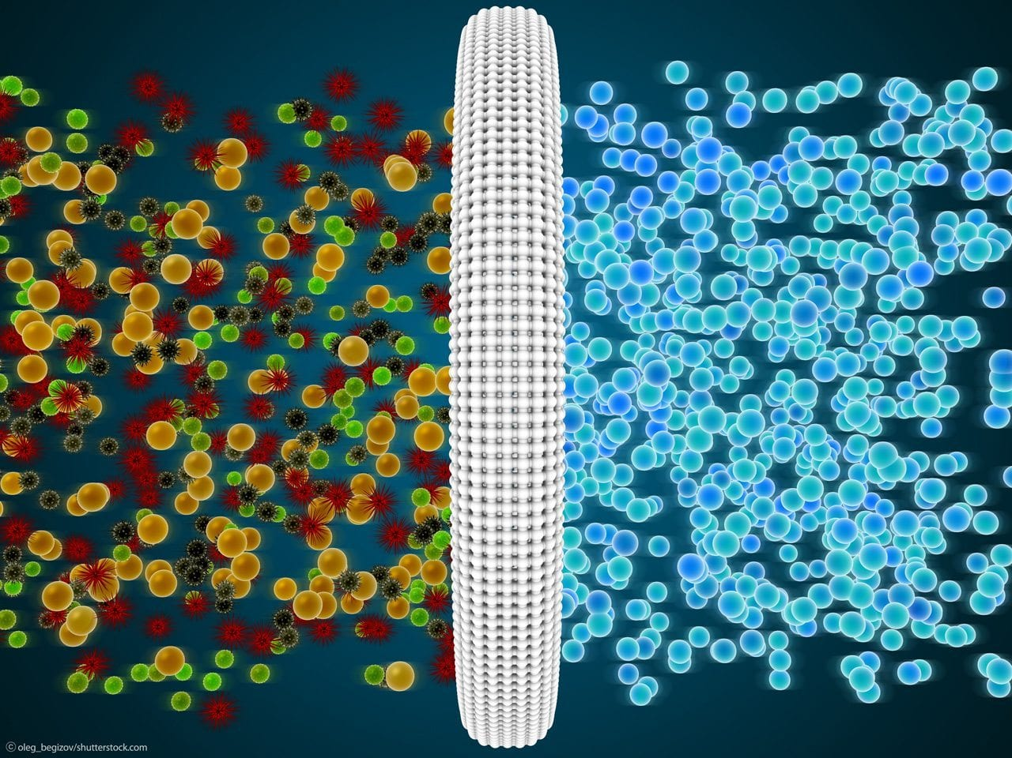
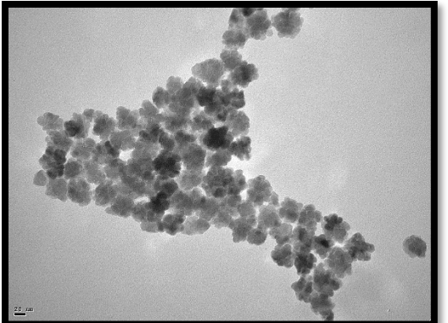
State of the art
fotocatálisis-microbiológico
métodos físico-químicos. Membranas o Flotación
Adsorción por nanopartículas magnéticas
Sánchez Limón, Gabriela (2020)
Almeida Streitwieser (2020)
Juan José castro (2020)

Slide 5
Objective
Design and simulate the magnetic interactions of a micromechanical non-contaminant device for inmovolization of contaminants (Azo Dye) produced by the textile industry on wastewaters

Slide 6

First draft

Slide 7
Scope and plan
Simulation of magnetic forces and interactions
Select and use specialized software to develop simulations and mathematical analysis .
3
Structural Design and materials selection
First, we designed the general structure of the microgripper and select the materials which are suitable to develop the desired result.
2
Analysis of forces and design a plan to continue with the simulations
Having the theory of the magnetic forces and the analysis of the magnetic interactions take a decision to generate a geometry
1

Slide 8
Materials and Methods

Slide 9
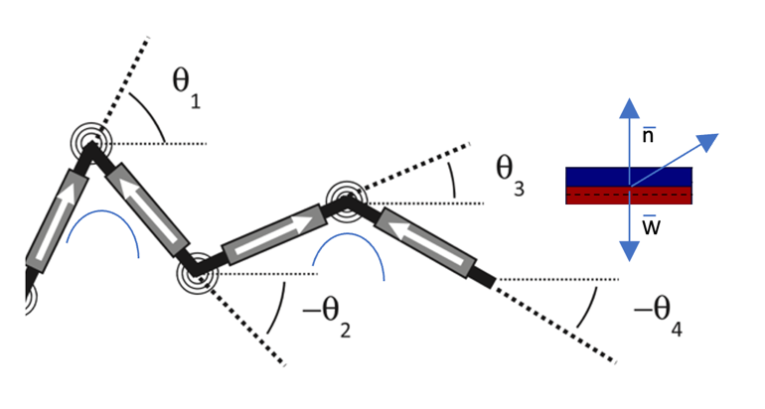
Description of the movement
Sheridan, R., Roche, J., & Lofland, S. E. (2014). Numerical simulation and experimental validation of the large deformation bending and folding behavior of magneto-active elastomer composites. Smart materials and structures, 23(9), 094004.

Slide 10
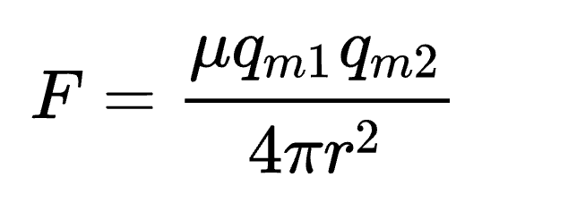
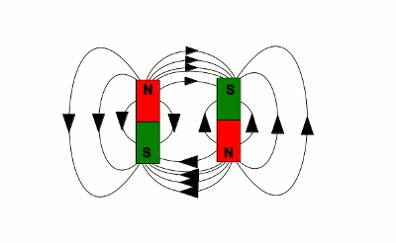
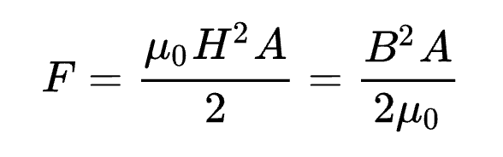
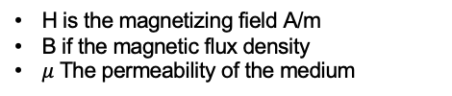
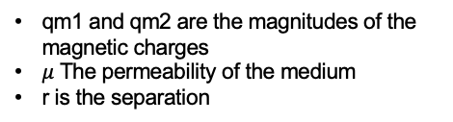
Calculating the magnetic forces
It depends:
Shape
Magnetization
Orientation
Separation
Force between two magnets
qm1 and qm2 are the magnitudes of the magnetic charges
$μ$ The permeability of the medium
r is the separation
Force between two nearby magnetized surfaces of area A
H is the magnetizing field A/m
B if the magnetic flux density
$μ$ The permeability of the medium
https://homofaciens.de/technics-electrical-engineering-magnets_en.htm

Slide 11
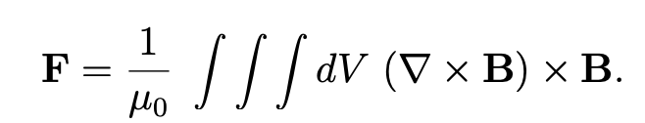
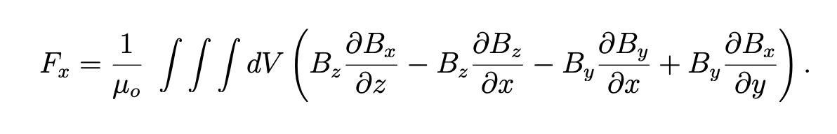
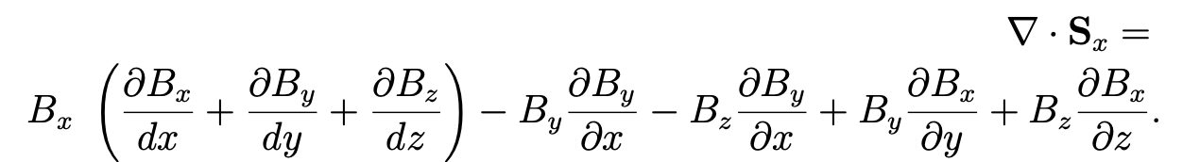
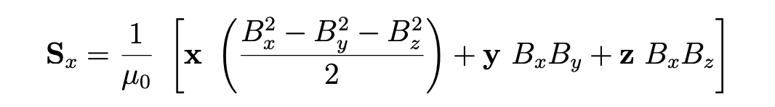
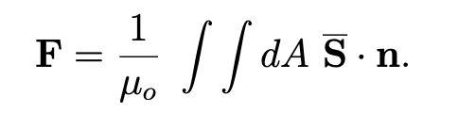
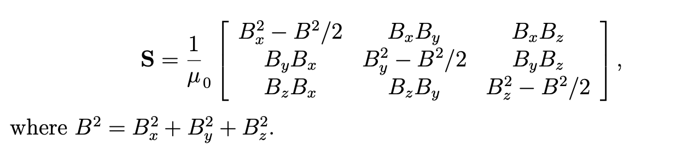
Force between a magnet and a surface of area A. Use Casex
Maxwell stress tensor may be used to calculate electric and magnetic forces on objects.
Divergence
11
Notes:
Consideraciones:https://www.fieldp.com/documents/stresstensor.pdf

Slide 12
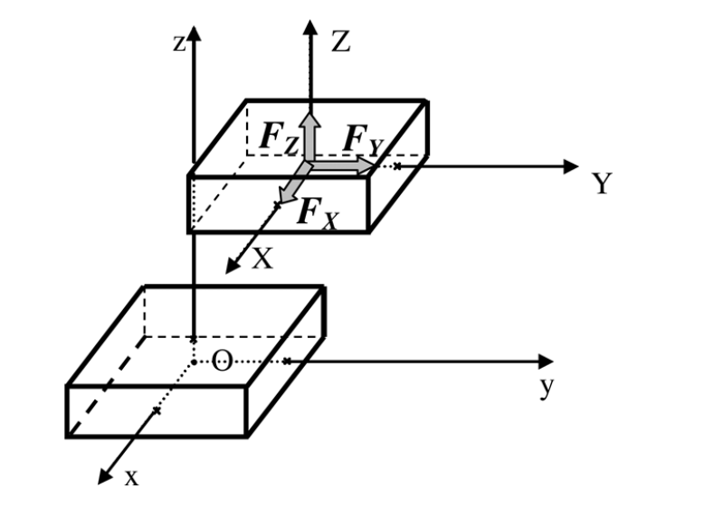
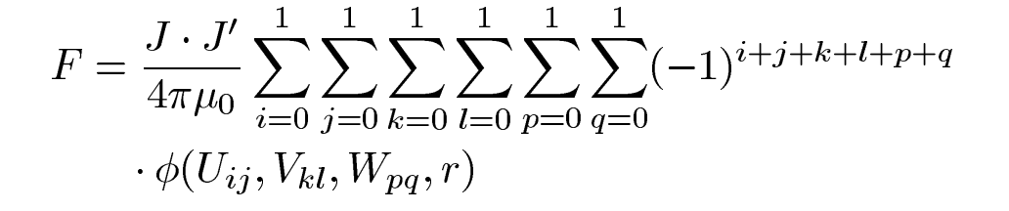
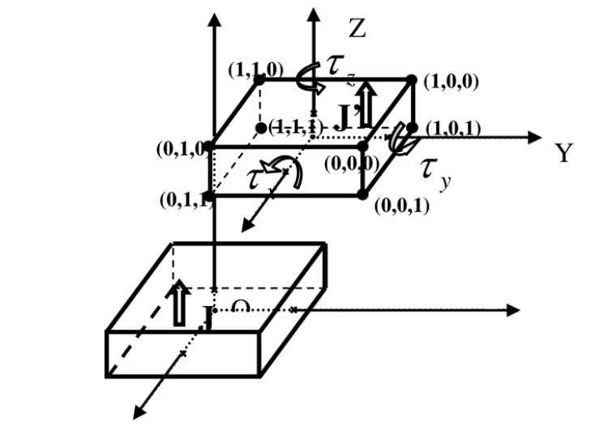
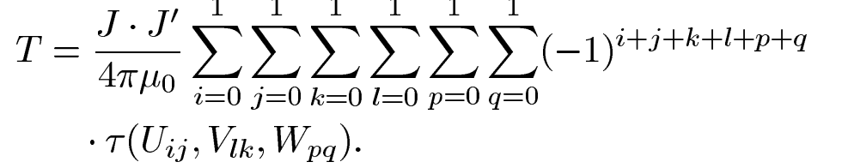
Magnetic Torque
The first element is supposed to be fixed and the second is submitted to a force.
The torque representation
Allag, H., & Yonnet, J. P. (2009). 3-D analytical calculation of the torque and force exerted between two cuboidal magnets. IEEE Transactions on Magnetics, 45(10), 3969-3972.

Slide 13


Comsol and Matlab
Analytical results using MATLAB and a public framework
Finite element analysis

Slide 14
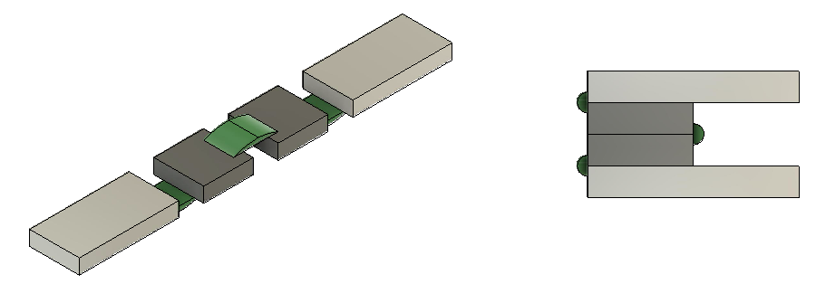
General structure and geometry design
1mm
1mm
Polymer
Contaminants
1.2mm
Magnet
0.3mm
Nickel soft Ferromagnetic
2mm
Extended
Folded

Slide 15
Results and analysis

Slide 16
Simulation results – Comsol
Magnetization and magnetic flux density Norm
Magnetic field and Magnetic fiux density x-axis

Slide 17
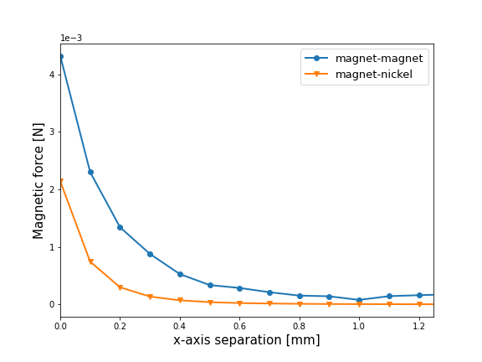
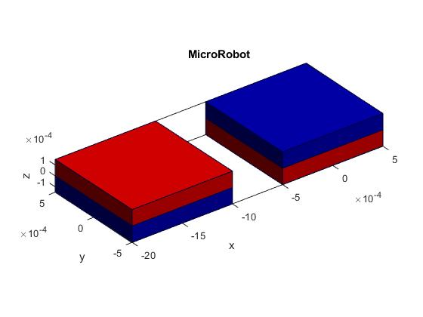
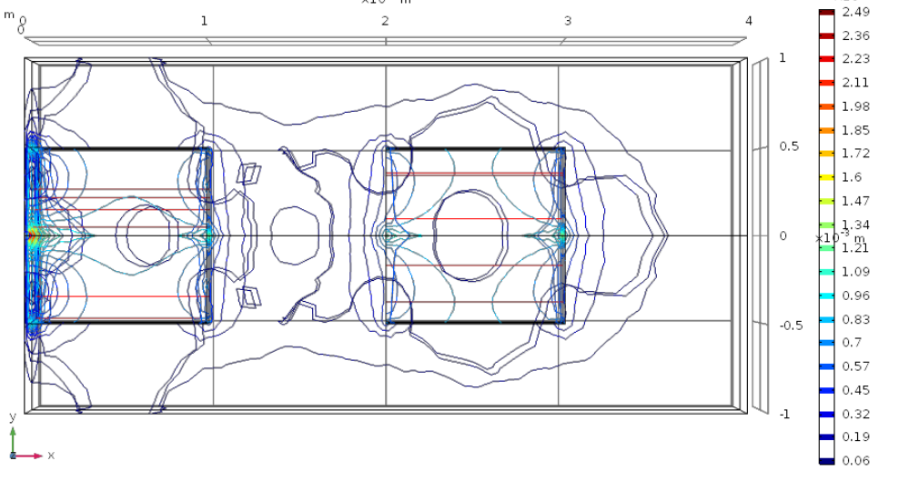
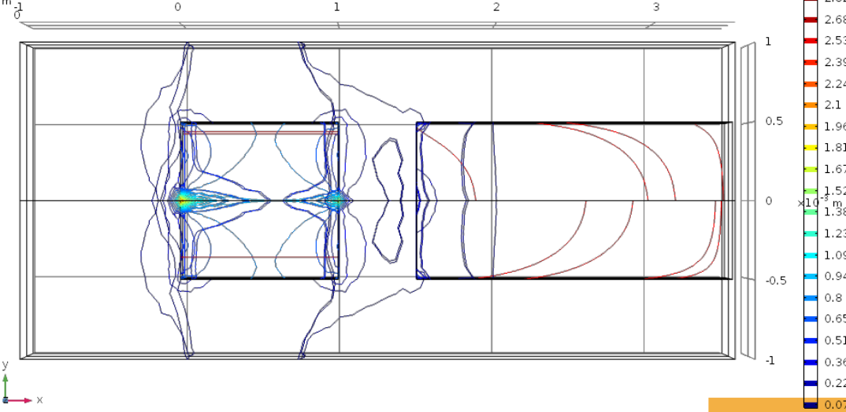
Magnetic flux density norm

Slide 18
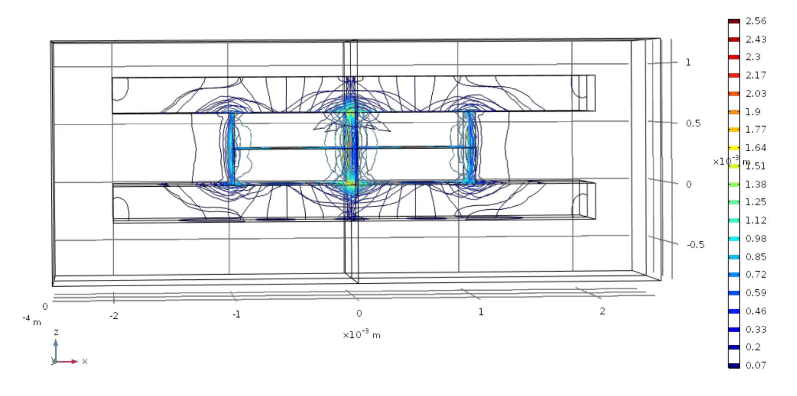
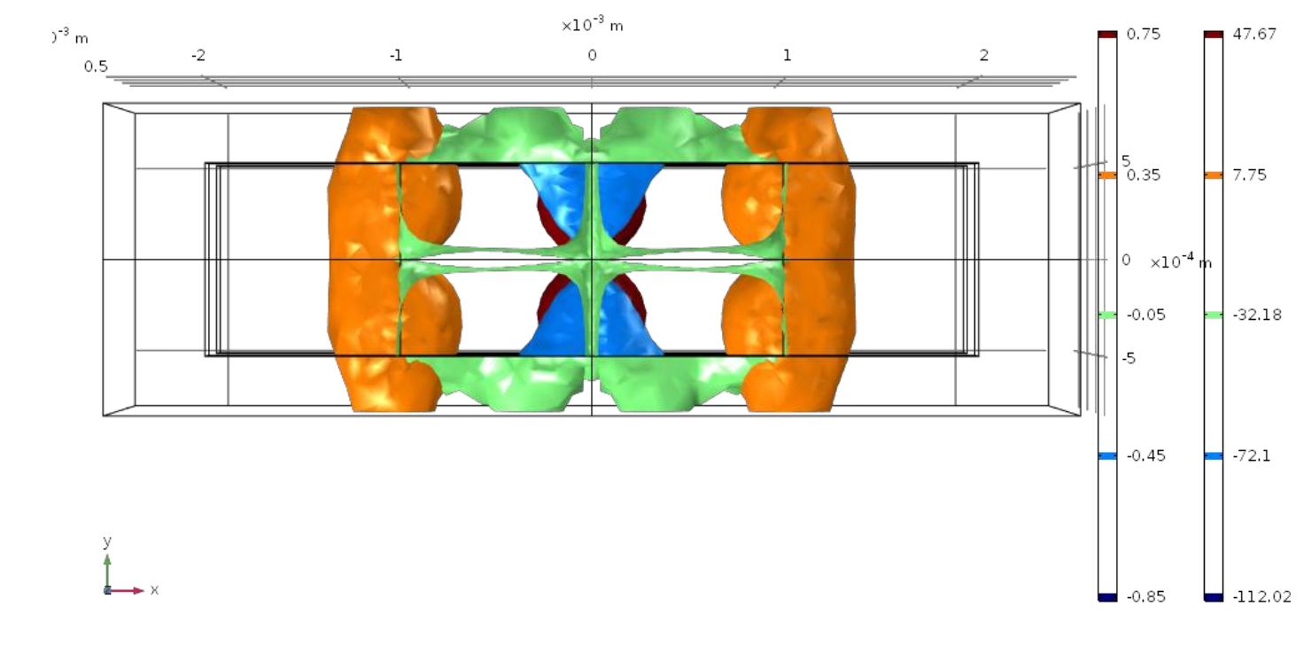
Two magnets configuration
Magnetic flux density norm
Magnetic field

Slide 19
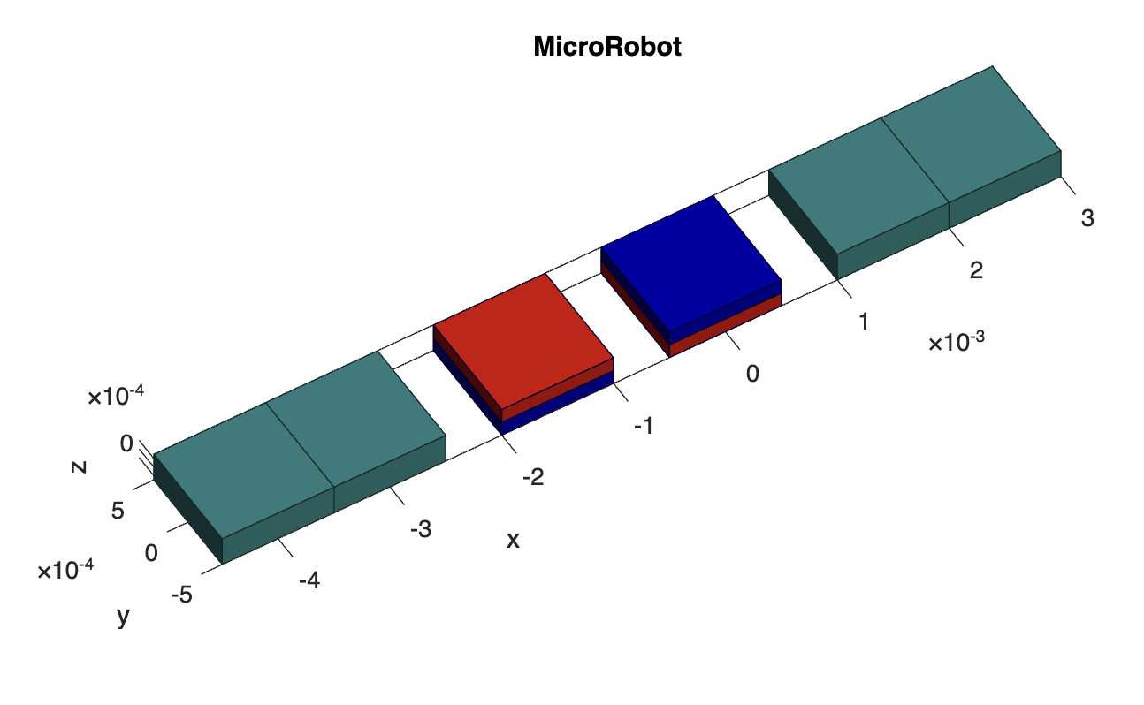
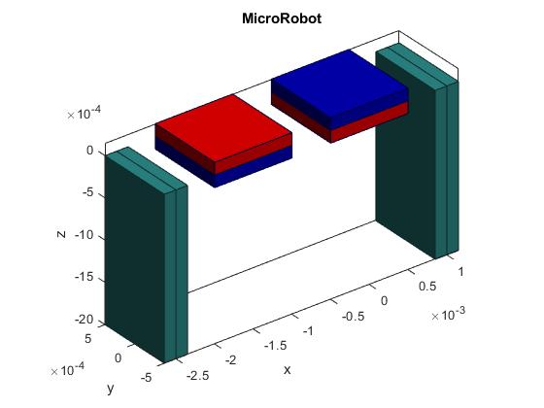
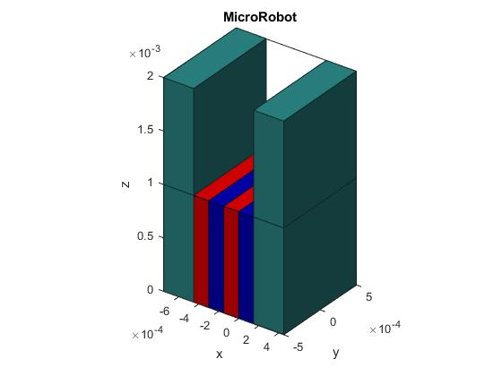
Analytical results - Matlab

Slide 20
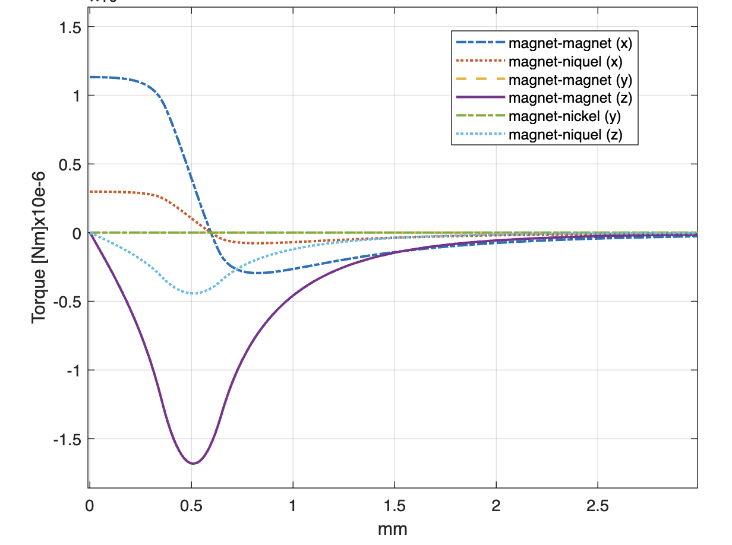
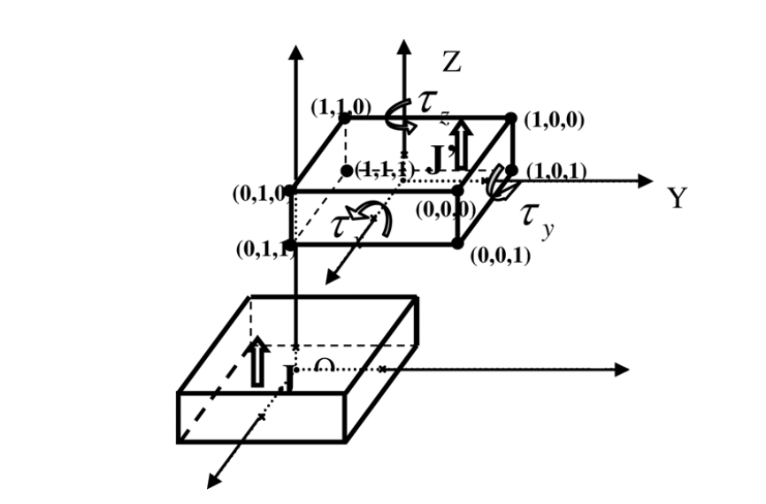
Magnetic Torque
Torque Nxm e-3

Slide 21
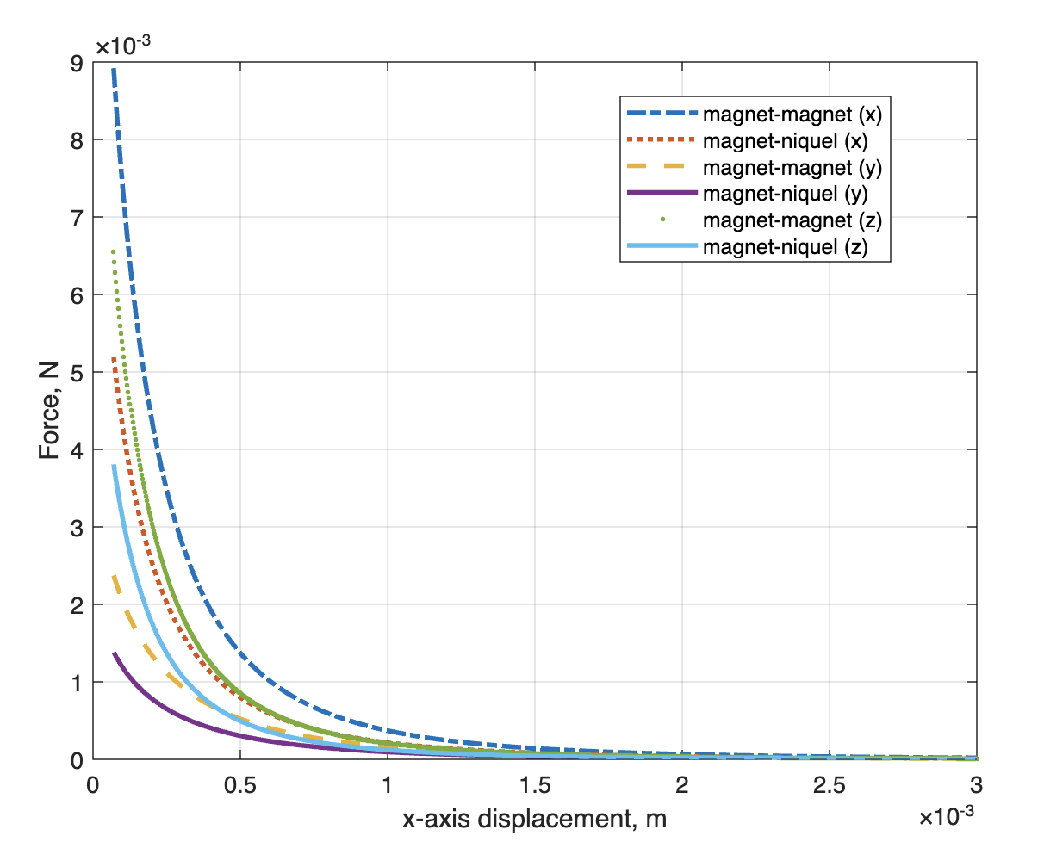
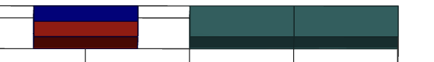
Magnetic Force

Slide 22
Conclusions
Magnetic analysis of a micromechanical device for the removal of contaminants on wastewaters.
Forces needed to control the devices
How to describe and predict the movement based on the magnetic forces
Scalalibity to other geometries
Base analysis and simulations with room to improve developing new integrations.
We developed a repository holding the process of the project for further developments

Slide 23
Future work
Proyects
Design and simulate magnetic microgrippers. Forces and interactions, analysis of how are the forces on the microrobot and how to use them.
Simulate and implement magnetic microgrippers. Actuation (open and closinng) using external magnetic forces. Intenractions for self assembly.
Surface functionalization for magnetic microgrippers. Structure functionalization for inmovilization of the pollulants and contaminants on water.
Control of magnetic microgrippers for self assembly using external magnetic forces. Implementation of external force source.
Path modeling algorithms for magnetic microgrippers on water. Using ML to simulate and estimate the trace followed.

Slide 24


Thanks!
Any questions?

